Slide 1
Lab 6.3.1-SLASH Merge
March , 2008

Slide 2
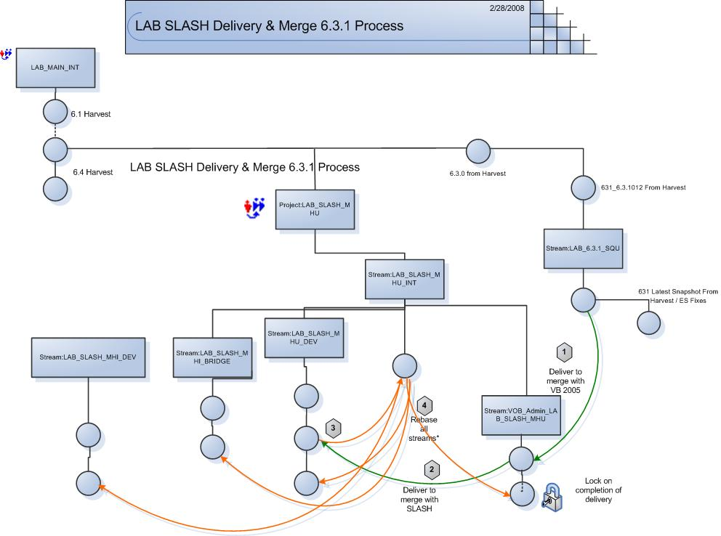
Stream and Project Layout

Slide 3
Usage
Continue to use Lab 6.3.1 stream for 6.3.1 defect fixes and ES projects
Continue to use Lab SLASH stream for SLASH Development
Continue to use SRM stream for future development
If required, either Merge Lab 6.3.1 latest code with SLASH/SRM streams in future, or can deliver selected activities from Lab 6.3.1 stream to other project streams
Create baselines of each project on completion and maintain it for branching and future use.

